Slide 1
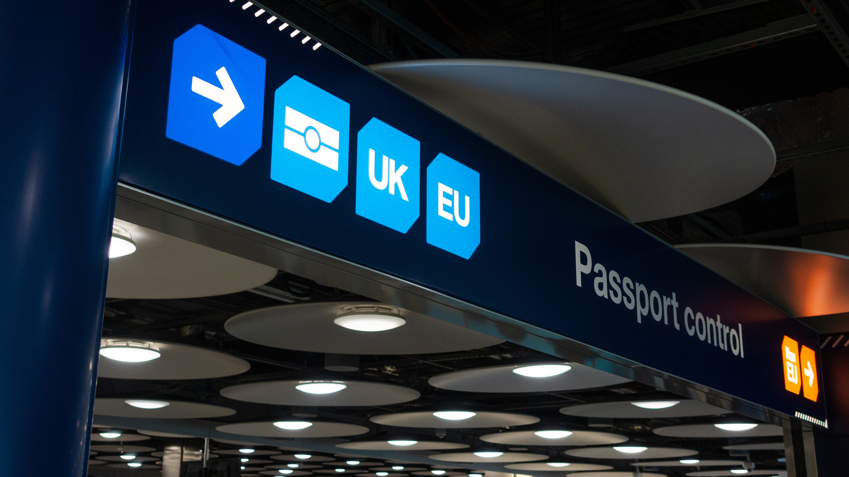
ATC Counter-Terrorism
Module 3: Schedule 7

Slide 2
Overview
This module aims to understand:
What is Schedule 7, and how is it enforced
How it fits in the Government's wider counter-terrorism plans, and its effectiveness
The major flaws in Schedule 7, including a lack of transparency, violation of human rights, and its Islamophobic application
MEND - COUNTERTERROR

Slide 3
What is Schedule 7
"Key part" of UK border security arrangements
Schedule 7 grants examining officers to stop & question individuals at UK ports and borders
Individuals are assessed to determine whether they may be involved in terrorist-related activity
In order to determine if an individual is a suspect or not
MEND - COUNTERTERROR

Slide 4
What Actually Happens During a Schedule 7 Stop?
Typically, a Schedule 7 stop has the following 3 steps:
Screening/Questioning
Involves simple questions
Examination
Public information leaflet
Further questioning
Examining officers may use existing knowledge of terrorist organisations and emerging activities
Individuals may be searched along with their belongings and any electronics
Detention
Notice of detention
Right to inform someone
Right to speak to a lawyer
MEND - COUNTERTERROR

Slide 5
How do you know if you have been stopped?
These powers are specific to ports and borders
Under examination, the officer must notify you either verbally or in writing that they are examining you under the powers of Schedule 7
At the start of every examination, you will be given a public information leaflet
If you are formally detained within the first hour, you will also be provided with a ‘Notice of Detention’ that reiterates your rights and legal obligations
MEND - COUNTERTERROR

Slide 6
What can be asked of me, and how much can I comply?
You may be asked for your passport and arrival/embarkation card
You must answer all questions put forward to you
You must give the examining officer any information in your possession
You must declare and had over any documents that is asked of
You may be searched along with anything that belongs to you
You may also be asked to provide fingerprints or other non-intimate biometric samples
You must provide all passwords and encryption keys for your devices
Failure to comply, or willingly obstructing justice is an offence to these provisions, and you may be prosecuted under the Terrorism Act 2000
MEND - COUNTERTERROR

Slide 7
What are my rights?
If detained, you have the right to:
Inform a friend, a relative or a person who is known to you
Consult a solicitor privately, whether in person or by telephone
You do not need to answer questions about other individuals, as this falls outside of Schedule 7 screening powers
MI5 may be interested in talking to you, however, you are not legally obliged to answer to them, and can politely refuse
If you are being searched, you may request for an officer of the same gender
MEND - COUNTERTERROR

Slide 8
How successful is it?
Of the 419,000 people stopped under Schedule 7 between 2009-2019, only 30 have been convicted
Out of the 325 million passengers that transited ports in 2018, 11,891 were stopped, and 1,836 were detained
Between March 2018 and 2019, there were only 3 convictions
Conviction rate between 2010 and 2019 is 0.007%
MEND - COUNTERTERROR

Slide 9
Flaws within Schedule 7
Transparency:
Home Office did not release statistics on its use for the first 8 years
Lack of available data based on ethnicity/religion
No clear breakdown of stops, examinations and detentions
Islamophobia:
78% of those being detained under Schedule 7 coming from ethnic minorities 2016
In a survey by CAGE, out of 201 people stopped, all but one were Muslims
Abuse of Powers:
Questions are often out of the remit of stops
MEND - COUNTERTERROR

Slide 10
“Schedule 7 is an enormous blunderbuss that is overused and the consequences of its overuse is that it is abusive”
UK-based human rights lawyer Gareth Peirce
MEND - COUNTERTERROR

Slide 11
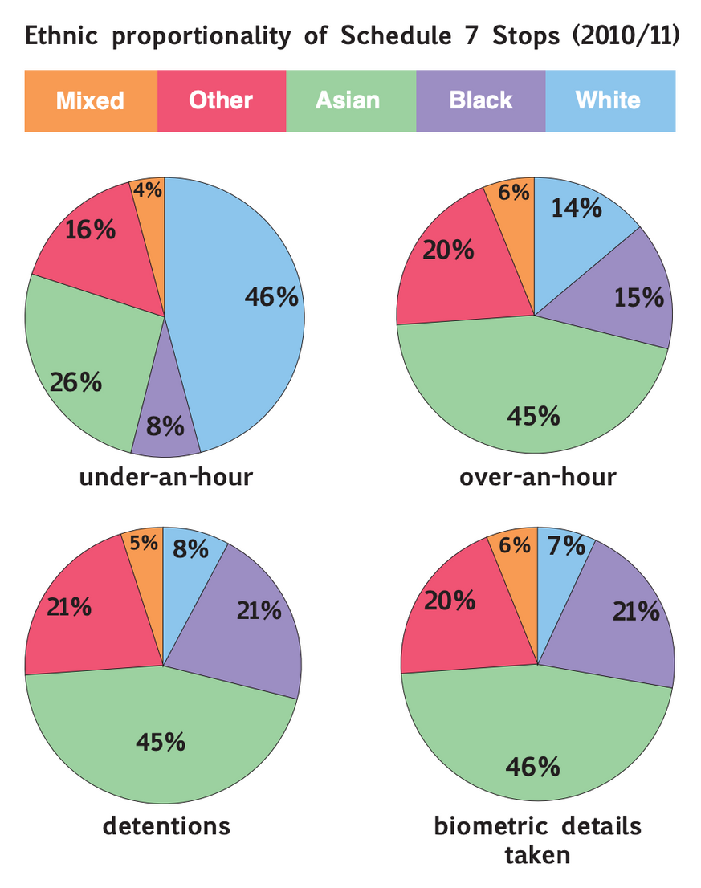

Slide 12
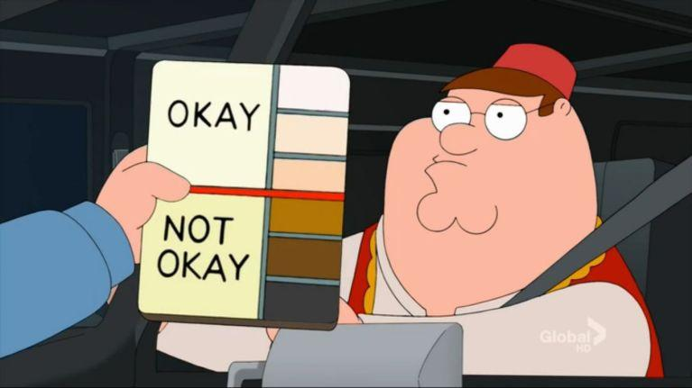

Slide 13
Impacts of Schedule 7 in the Muslim Community
Psychological impacts on children
Criminalisation of activists and aid workers
Limitations on Freedom of Speech
Surveillance on Muslim communities
Distrust between Counter-Terror police and policies
MEND - COUNTERTERROR

Slide 14
"The crux of the problem with Schedule 7 is its disregard for the norms of due process. Like many other counter-terrorism laws, the usual criminal law safeguards are discarded under Schedule 7, resulting in an unjust, draconian piece of legislation which is not only unsuitable for the purpose that it is supposedly billed for, but which permits and justifies systematic abuses against individuals."
Cage
MEND - COUNTERTERROR

